Slide 1

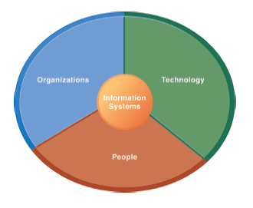
The Institute of Finance Management
ITU08117:
Information Systems Management
BAIT III
Mugyabuso, M. L
2022-2023
Notes:
There are two video cases and two instructional videos available for this chapter.

Slide 2
Business Environment and Role of Information Systems in Business
Components of Business
Types of Information Systems
Collaboration and Teamwork

Slide 3
Components of a Business
Business: formal organization that makes products or provides a service in order to make a profit
Organizing a Business: Basic Business Functions
Four basic business functions
Manufacturing and production
Sales and marketing
Finance and accounting
Human resources
Notes:
Emphasize each element in the definition of “business.” What is meant by “formal organization”? Formal organizations get to be “formal” in part because they are chartered by the nation state (a country’s legal system). As a result, they have certain powers and obligations to perform. How might businesses differ depending on whether they make products or provide services? What role does profit play in business?

Slide 4
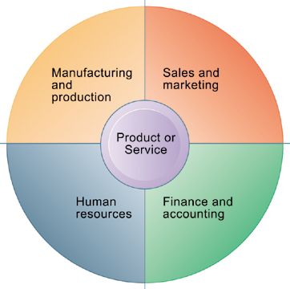
Components of a Business
The Four Major Functions of a Business
Every business, regardless of its size, must perform four functions to succeed. It must produce the product or service; market and sell the product; keep track of accounting and financial transactions; and perform basic human resources tasks, such as hiring and retaining employees.
Figure 2-1
Notes:
Emphasize that each function is critical to any business, and explain that the product or service is at the center of the diagram because it “governs” the way each business approaches the four major business functions.

Slide 5
Components of a Business
Five Basic Business Entities
Suppliers
Customers
Employees
Invoices/payments
Products and services
Notes:
You can describe any business in terms of these five elements. Ask a student who has work experience to describe the business entities as his/her current place of work.

Slide 6
Components of a Business
Business Processes
Logically related set of tasks that define how specific business tasks are performed
The tasks each employee performs, in what order, and on what schedule
E.g., steps in hiring an employee
Some processes tied to functional area
Sales and marketing: identifying customers
Some processes are cross-functional
Fulfilling customer order
Notes:
Ask students to describe some example business processes based on their personal work experiences. Examples might include assembling a product, identifying customers, paying creditors, or hiring employees.

Slide 7
Components of a Business
Managing a Business and Firm Hierarchies
Firms coordinate work of employees by developing hierarchy in which authority is concentrated at top.
Senior management
Middle management
Operational management
Knowledge workers
Data workers
Production or service workers
Each group has different needs for information.
Notes:
Ask students what types of information are pertinent to each level of the hierarchy. Senior managers need summary information that can quickly inform them about the overall performance of the firm; middle managers need more specific information on the results of specific functional areas of the firm; and so on.

Slide 8
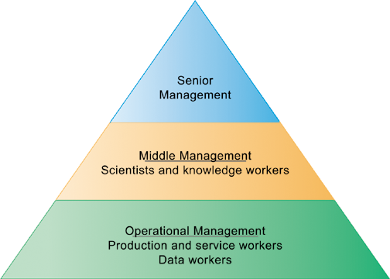
Components of a Business
Levels in a Firm
Business organizations are hierarchies consisting of three principal levels:
senior management, middle management, and operational management. Information systems serve each of these levels. Scientists and knowledge workers often work with middle management.
Figure 2-3
Notes:
Emphasize to students that different information systems are used by different levels of the pyramid.

Slide 9
Components of a Business
The Business Environment
Global environment factors
Technology and science
Economy
Politics
International change
Immediate environment factors
Customers
Suppliers
Competitors
Regulations
Stockholders
Notes:
Ask students to give examples of how factors like politics and international change affect business based on their own experiences. One obvious example is political disruption in the Middle East and its impact on oil and gas prices around the world.

Slide 10
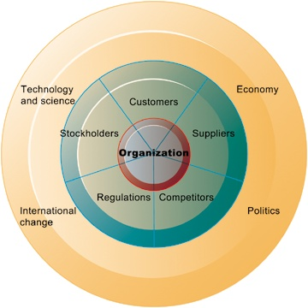
Components of a Business
The Business Environment
To be successful, an organization must constantly monitor and respond to—or even anticipate—developments in its environment. A firm’s environment includes specific groups with which the business must deal directly, such as customers, suppliers, and competitors as well as the broader general environment, including socioeconomic trends, political conditions, technological innovations, and global events.
Figure 2-4
Notes:
Emphasize to students that the outer ring consists of factors which are not a part of businesses and organizations, but nevertheless have a significant impact on the way a business is run and how well it performs. Obviously, the health of the larger economy effects businesses. How does development in technology and science impact business?

Slide 11
Components of a Business
The Role of Information Systems in a Business
Firms invest in information systems in order to:
Achieve operational excellence
Develop new products and services
Attain customer intimacy and service
Improve decision making
Promote competitive advantage
Ensure survival
Notes:
To accomplish business objectives, businesses develop and use information systems.

Slide 12
Types of Business Information Systems
Systems for Management Decision Making and Business Intelligence
Transaction processing systems (TPS)
Keep track of basic activities and transactions of organization
Systems for business intelligence
Address decision-making needs of all levels of management
Management information systems (MIS)
Decision support systems (DSS)
Executive support systems (ESS)
Notes:
The constituency perspective emphasizes which groups in the firm are served by specific systems.

Slide 13
Types of Business Information Systems
Transaction processing systems:
Serve operational managers
Principal purpose is to answer routine questions and to track the flow of transactions through the organization
E.g., inventory questions, granting credit to customer
Monitor status of internal operations and firm’s relationship with external environment
Major producers of information for other systems
Highly central to business operations and functioning
Notes:
TPS systems are really the most basic kind of information system in a business, and they were among the first to be developed. A business is in large part a collection of transactions. Keeping track of all these transactions is the fundamental job of management. Without this, the business would soon collapse. Ask students for examples of a “transaction” in a business and make sure they understand the fundamental role of transactions.

Slide 14
Types of Business Information Systems
Management information systems:
Provide middle managers with reports on firm’s performance
To monitor firm and help predict future performance
Summarize and report on basic operations using data from TPS
Provide weekly, monthly, annual results, but may enable drilling down into daily or hourly data
Typically not very flexible systems with little analytic capability
Notes:
MIS—management information systems—are used by middle and general managers to summarize and keep track of all the important transactions in a business firm. In some sense, being a manager means keeping track of transactions.

Slide 15
Types of Business Information Systems
Decision support systems (DSS):
Serve middle managers
Support nonroutine decision making
E.g., What is impact on production schedule if December sales doubled?
Often use external information as well from TPS and MIS
Model driven DSS
Voyage-estimating systems
Data driven DSS
Intrawest’s marketing analysis systems

Slide 16
Types of Business Information Systems
Executive support systems (ESS):
Serve senior managers
Address strategic issues and long-term trends
E.g., What products should we make in five years?
Address nonroutine decision making
Provide generalized computing capacity that can be applied to changing array of problems
Draw summarized information from MIS, DSS, and data from external events
Typically use portal with Web interface, or digital dashboard, to present content
Notes:
ESS are high level systems aimed at senior managers that summarize the performance of the firm along key dimensions, e.g., sales by region, product sales, cost of goods used in production, and weekly summaries of financial data. Usually, this data is presented in an attractive “digital dashboard” interface.

Slide 17
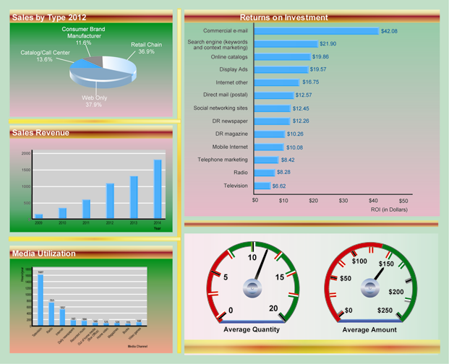
Types of Business Information Systems
Digital Dashboard
A digital dashboard
delivers comprehensive
and accurate information
for decision making
often using a single
screen. The graphical
overview of key performance
indicators helps
managers quickly
spot areas that need
attention.
Notes:
Why is it that digital dashboards are more effective than, say, spreadsheets with rows and columns of the same data? One answer is just the cognitive cost of looking for “information” in table of rows and columns is much greater than looking at a graphical representation of the same data.

Slide 18
Types of Business Information Systems
Systems for Linking the Enterprise
Enterprise applications
Systems that span functional areas, focus on executing business processes across the firm, and include all levels of management
Four major types
Enterprise systems
Supply chain management systems
Customer relationship management systems
Knowledge management systems
Notes:
ERP systems integrate business processes in manufacturing and production, finance and accounting, sales and marketing, and human resources into a single software system.
SCM systems help businesses manage relationships with their suppliers.
CRM systems help businesses manage relationships with their customers
KMS systems enable organizations to better manage processes for capturing and applying knowledge and expertise.

Slide 19
Types of Business Information Systems
Enterprise Systems
Also called enterprise resource planning (ERP) systems
Integrate data from key business processes into single system
Speed communication of information throughout firm
Enable greater flexibility in responding to customer requests, greater accuracy in order fulfillment
Enable managers to assemble overall view of operations
Notes:
The alternative to enterprise systems is departmental systems. What’s wrong with each department, say marketing and accounting, having their own systems to serve their needs?

Slide 20
Types of Business Information Systems
Supply Chain Management Systems
Manage relationships with suppliers, purchasing firms, distributors, and logistics companies
Manage shared information about orders, production, inventory levels, and so on
Goal is to move correct amount of product from source to point of consumption as quickly as possible and at lowest cost
Type of interorganizational system:
Automating flow of information across organizational boundaries
Notes:
Do students have any examples of supply chains based on their work experience? What are some of the difficulties they encountered? Some likely candidates are slow delivery, mistakes in delivery, inability to supply because of lack of inventory, delivery to wrong location, and so forth.

Slide 21
Types of Business Information Systems
Customer Relationship Management Systems
Help manage relationship with customers
Coordinate business processes that deal with customers in sales, marketing, and customer service
Goals:
Optimize revenue
Improve customer satisfaction
Increase customer retention
Identify and retain most profitable customers
Notes:
Have students interacted with a CRM? Most have but don’t realize it. Most everyone has interacted with a call center over the phone. What has been the experience of your students dealing with call centers? Why do they think call centers are important to a business? What’s the worst experience they have had? Often it’s a cable company or other utility. Or a bad experience with a foreign-based call center where customer service reps could not be easily understood. Why can service at call centers be so poor?

Slide 22
Essentials of Management Information Systems
Chapter 2 Global E-Business and Collaboration
Types of Business Information Systems
Knowledge Management Systems
Manage processes for capturing and applying knowledge and expertise
Collect relevant knowledge and make it available wherever needed in the enterprise to improve business processes and management decisions
Link firm to external sources of knowledge
Notes:
Most students will never have heard of a “knowledge management system.” In one sense its just a corporate library which contains documents, even books, but also reports, PowerPoint slides, spreadsheets, in short, a collection of everything a firm (the people in it) knows about the business. Everyone knows (or did know) what a library is. Another way to think about knowledge management is to think about Google being a collection of part of what is known or thought to be in the world. A good knowledge management system would allow employees to search a corporate database just like searching Google.

Slide 23
Types of Business Information Systems
Intranets and Extranets
Technology platforms that increase integration and expedite the flow of information
Intranets:
Internal networks based on Internet standards
Often are private access area in company’s Web site
Extranets:
Company Web sites accessible only to authorized vendors and suppliers
Facilitate collaboration
Notes:
The distinction between intranets and extranets is still common. Yet many companies simply talk about their “Web site” and the various areas of their Web site where access is confined to specific groups. Restricted areas of their Web sites are available only to employees (intranets). Other areas are open to outside suppliers, or customers (extranets). The important point is that no matter how you refer to the phenomenon, firms use their Web sites (many firms have multiple Web sites—some for strictly internal use, and some for use by outside parties) to deliver services and information to all the parties in their business value system, from suppliers to consumers.

Slide 24
Types of Business Information Systems
E-Business, E-Commerce, and E-Government
E-business:
Use of digital technology and Internet to drive major business processes
E-commerce:
Subset of e-business
Buying and selling goods and services through Internet
E-government:
Using Internet technology to deliver information and services to citizens, employees, and businesses

Slide 25
Systems for Collaboration and Teamwork
What Is Collaboration?
Growing Importance of collaboration:
Changing nature of work
Growth of professional work
Changing organization of the firm
Changing scope of the firm
Emphasis on innovation
Changing culture of work and business
Notes:
A number of factors are leading to a growing emphasis on collaboration in the firm. Work is changing, requiring more cooperation and coordination. Professions play a larger role in firms than before, and this often requires more consultation among experts than before. Organizations are flatter, with many more decisions made far down in the hierarchy. Organizations are more far flung around the globe, in multiple locations. There’s an emphasis on finding and sharing ideas, which requires collaboration. Finally, what it means to be a “good” employee these days is in part an ability to work with others and collaborate effectively. The culture of work has changed.

Slide 26
Systems for Collaboration and Teamwork
Business Benefits of Collaboration and Teamwork
Recent surveys find that investment in collaboration technology can return large rewards, especially in:
Sales and marketing
Research and development
Older, “command and control,” hierarchical management allowed little horizontal communication
Today, businesses rely more on teams at all levels
Notes:
Some of the benefits of collaboration and team work are greater productivity, faster reaction to market events, more innovation, and faster implementation times than previously without collaboration (command and control model). Ask students about their experience on the job with collaboration and team work. Have any worked in a more traditional “command and control” business?
26

Slide 27
Systems for Collaboration and Teamwork
Tools and Technologies for Collaboration and Teamwork
E-mail and instant messaging (IM)
Social networking
Wikis
Virtual worlds
Internet-based collaboration environments
Virtual meeting systems (telepresence)
Google Apps/Google Sites
Microsoft SharePoint
Lotus Notes
Notes:
There’s been an explosion in collaboration tools and environments. Businesses are just now learning how to use them.
27

Slide 28
NEXT
Achieving Competitive Advantage with Information Systems
Notes:
IS services departments deliver specialized services to most other units of the organization, as well as providing the overall computer infrastructure in a firm that serves everyone.

